Slide 1


Flag Disaster Tweets
Facoltà di Ingegneria dell’informazione, informatica e statistica
Corso di Laurea in Informatica
Big Data Computing
Hazem Dewidar
Prof. Gabriele Tolomei

Slide 2

Twitter

Slide 3
Twitter
Twitter is nowdays a great source of information

Slide 4
Twitter
Twitter is nowdays a great source of information
Newspapers
User Tweets

Slide 5
Twitter
Twitter is nowdays a great source of information
Newspapers
User Tweets
CNN
New York Times
Al-jazeera

Slide 6
Twitter
Twitter
Twitter is nowdays a great source of information
Newspapers
User Tweets
From your feed
Live tweets about an event
Testimonials

Slide 7
Twitter
Newspapers
User Tweets
What can we do with this source?
From your feed
Live tweets about an event
Testimonials

Slide 8
What can we do with this source?
Sentiment
Analysis
Disaster Prediction
Clustering
We can group tweets based on the their content. In this way we can uncover patterns, topics and trends
Grouping tweets

Slide 9
What can we do with this source?
Sentiment
Analysis
Disaster Prediction
Clustering
In this way we can determine the emotion expressed in the tweet. This can be particularly useful for brands
Review Polarity

Slide 10


What can we do with this source?
Sentiment
Analysis
Disaster Prediction
Clustering
We can classify whether a tweet is about a disaster or not.
This can be particularly useful for limiting content to children or to help emergency responders
Disaster Prediction

Slide 11

What can we do with this source?
Sentiment
Analysis
Disaster Prediction
Clustering
The sky is ablaze
Disaster Prediction

Slide 12

What can we do with this source?
Sentiment
Analysis
Disaster Prediction
Clustering
The sky is ablaze
Disaster Prediction

Slide 13

What can we do with this source?
Sentiment
Analysis
Disaster Prediction
Clustering
The sky is ablaze
Disaster Prediction
My house is ablaze

Slide 14

What can we do with this source?
Sentiment
Analysis
Disaster Prediction
Clustering
The sky is ablaze
Disaster Prediction
My house is ablaze

Slide 15

What can we exploit this source?
Sentiment
Analysis
Disaster Prediction
Clustering
How can we exploit this source?

Slide 16
What can we exploit this source?
Sentiment
Analysis
Disaster Prediction
Clustering
How can we exploit this source?
We can train a binary classifier that, given a tweet, will output whether it’s about a disaster or not
1
Pre-processing
Get words embeddings
Prediction

Slide 17
What can we exploit this source?
Sentiment
Analysis
Disaster Prediction
Clustering
How can we exploit this source?
We can train a binary classifier that, given a tweet, will output whether it’s about a disaster or not
Pre-processing
Get words embeddings
Prediction
2

Slide 18
What can we exploit this source?
Sentiment
Analysis
Disaster Prediction
Clustering
How can we exploit this source?
We can train a binary classifier that, given a tweet, will output whether it’s about a disaster or not
Pre-processing
Get words embeddings
Prediction
3

Slide 19
What can we exploit this source?
Sentiment
Analysis
Disaster Prediction
Clustering
How can we exploit this source?
Pre-processing
Get words embeddings
Prediction
TEXT CLEANING
TOKENIZATION
STOPWORDS REMOVAL
STEMMING

Slide 20
What can we exploit this source?
Sentiment
Analysis
Disaster Prediction
Clustering
How can we exploit this source?
Pre-processing
Get words embeddings
Prediction
Case normalization to lower
Trimming of the outer white spaces
Filtering symbols
Filtering extra white spaces between words
TEXT CLEANING
TOKENIZATION
STOPWORDS REMOVAL
STEMMING

Slide 21
What can we exploit this source?
Sentiment
Analysis
Disaster Prediction
Clustering
How can we exploit this source?
Pre-processing
Get words embeddings
Prediction
Splitting the text into a list of words
TEXT CLEANING
TOKENIZATION
STOPWORDS REMOVAL
STEMMING

Slide 22
What can we exploit this source?
Sentiment
Analysis
Disaster Prediction
Clustering
How can we exploit this source?
Pre-processing
Get words embeddings
Prediction
Removal of the common frequent words like: ‘is’ ‘are’ ‘our’
TEXT CLEANING
TOKENIZATION
STOPWORDS REMOVAL
STEMMING

Slide 23
What can we exploit this source?
Sentiment
Analysis
Disaster Prediction
Clustering
How can we exploit this source?
Pre-processing
Get words embeddings
Prediction
It reduces words to their base/root form
TEXT CLEANING
TOKENIZATION
STOPWORDS REMOVAL
STEMMING

Slide 24
What can we exploit this source?
Sentiment
Analysis
Disaster Prediction
Clustering
How can we exploit this source?
Pre-processing
Get words embeddings
Prediction
Gensim Library
The solution

Slide 25
What can we exploit this source?
Sentiment
Analysis
Disaster Prediction
Clustering
How can we exploit this source?
Pre-processing
Get words embeddings
Prediction
Gensim is a library for NLP tasks that, among other things, offers already trained models for topic modeling, document similarity and
Gensim Library
Word vector representations

Slide 26
What can we exploit this source?
Sentiment
Analysis
Disaster Prediction
Clustering
How can we exploit this source?
Pre-processing
Get words embeddings
Prediction
Glove is an unsupervised learning algorithm for dense vector representations of words. It’s based on the fact that words occurring in similar contexts tend to have similar meaning
Gensim Library
Word vector representations

Slide 27
What can we exploit this source?
Sentiment
Analysis
Disaster Prediction
Clustering
How can we exploit this source?
Pre-processing
Get words embeddings
Prediction
pySpark models
Keras LSTM

Slide 28
What can we exploit this source?
Sentiment
Analysis
Disaster Prediction
Clustering
How can we exploit this source?
Pre-processing
Get words embeddings
Prediction
Support Vector Classifier
Multi Layer Perceptron
Decision Tree
Random Forest
Gradient Boost Tree
Logistic Regression
pySpark models
Keras LSTM

Slide 29
What can we exploit this source?
Sentiment
Analysis
Disaster Prediction
Clustering
How can we exploit this source?
Pre-processing
Get words embeddings
Prediction
LSTM are a type of Recurrent Neural Network. They are very effective in task involving sequeces.
Furthermore, I’ve decided that this model will learn its word embeddings and will not use GloVe
pySpark models
Keras LSTM

Slide 30
What can we exploit this source?
Sentiment
Analysis
Disaster Prediction
Clustering
How can we exploit this source?
Pre-processing
Get words embeddings
Prediction
This model is then used for the live classification on the application I’ve developed
pySpark models
Keras LSTM

Slide 31
What can we exploit this source?
Sentiment
Analysis
Disaster Prediction
Clustering
The Dataset

Slide 32

What can we exploit this source?
Sentiment
Analysis
Disaster Prediction
Clustering
The Dataset
The dataset originally had columns:
Text
Target
5
ID
Location
Keyword

Slide 33
What can we exploit this source?
Sentiment
Analysis
Disaster Prediction
Clustering
The Dataset
The dataset originally had columns:
Text
Target
5
ID
Location
Keyword
We are only interested in the first two columns.

Slide 34
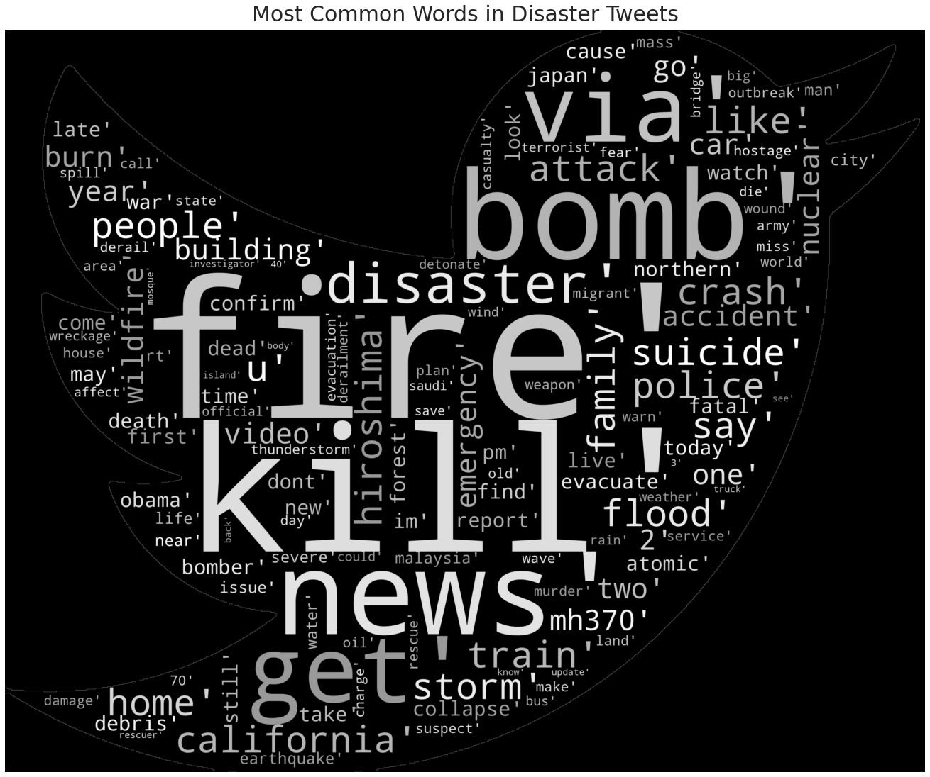
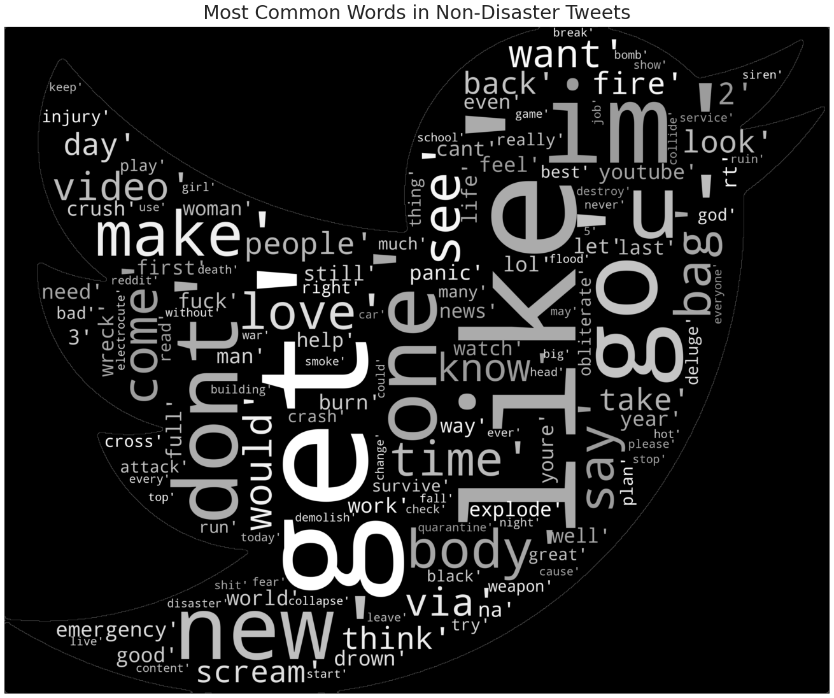
The Dataset
The dataset originally had columns:
Text
Target
2
We are only interested in the first two columns.

Slide 35
The Dataset
Hand annotated labels

Slide 36
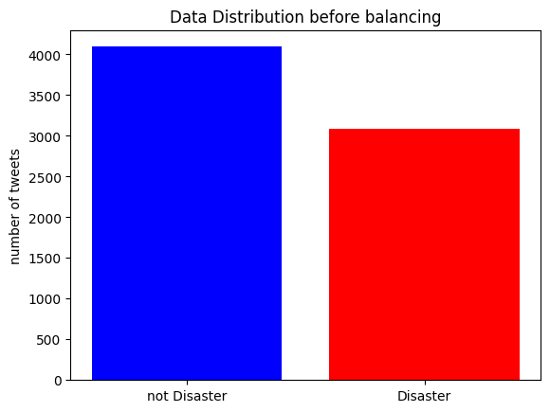
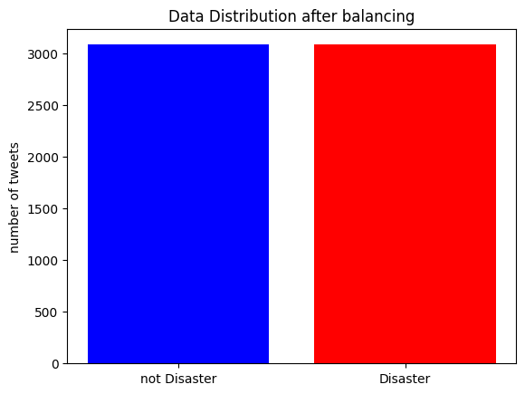
The Dataset
Very small dataset: only 6k rows
There is bias and there can be misinterpretation of the tweets

Slide 37
The Dataset
Very small dataset: only 6k rows
Solution: Down Sampling

Slide 38
The Dataset
Very small dataset: only 6k rows
Solution: Down Sampling

Slide 39
The Dataset
Very small dataset: only 6k rows
Solution: Down Sampling

Slide 40
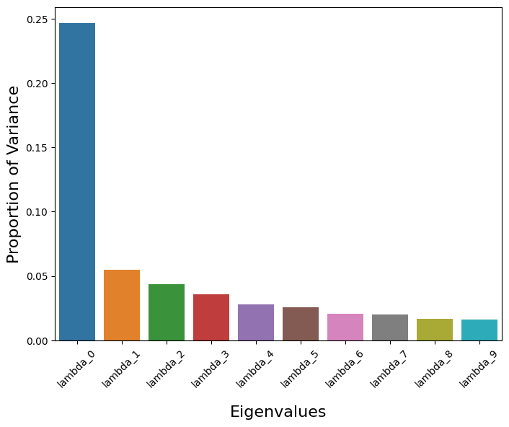
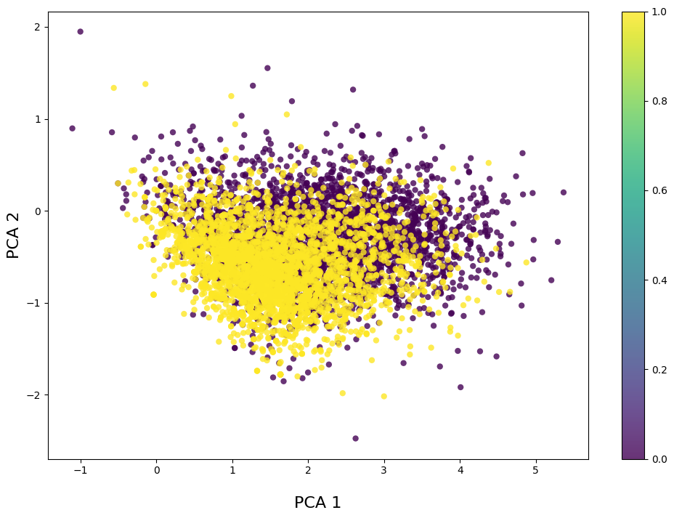
The Dataset
Principal Component Analysis:
Solution: Down Sampling

Slide 41
The Dataset
Principal Component Analysis:
Solution: Down Sampling

Slide 42
What can we exploit this source?
pySpark Models

Slide 43
pySpark Models
Support Vector Classifier
Multi Layer Perceptron
Decision Tree
Random Forest
Gradient Boost Tree
Logistic Regression

Slide 44
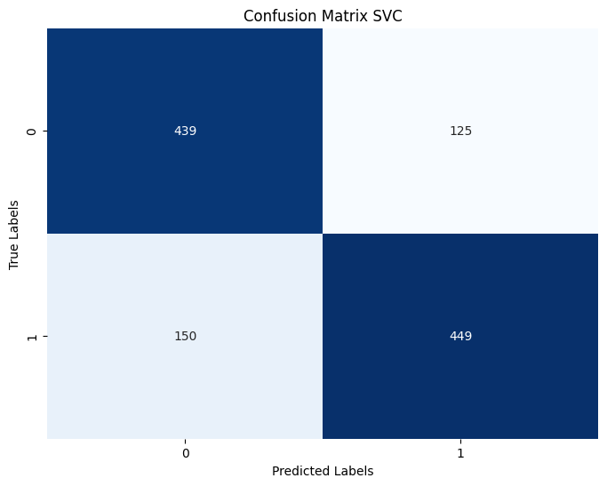
pySpark Models
Support Vector Classifier
Multi Layer Perceptron
Decision Tree
Random Forest
Gradient Boost Tree
Logistic Regression

Slide 45
pySpark Models
Support Vector Classifier
 | Precision | Recall | F1 Score | Accuracy
0 | 0.75 | 0.78 | 0.76
1 | 0.78 | 0.75 | 0.77
 |  |  |  | 0.76
Multi Layer Perceptron
Decision Tree
Random Forest
Gradient Boost Tree
Logistic Regression

Slide 46

pySpark Models
Support Vector Classifier
Multi Layer Perceptron
Decision Tree
Random Forest
Gradient Boost Tree
Logistic Regression

Slide 47
pySpark Models
Support Vector Classifier
Multi Layer Perceptron
 | Precision | Recall | F1 Score | Accuracy
0 | 0.73 | 0.81 | 0.77
1 | 0.80 | 0.72 | 0.76
 |  |  |  | 0.76
Decision Tree
Random Forest
Gradient Boost Tree
Logistic Regression

Slide 48
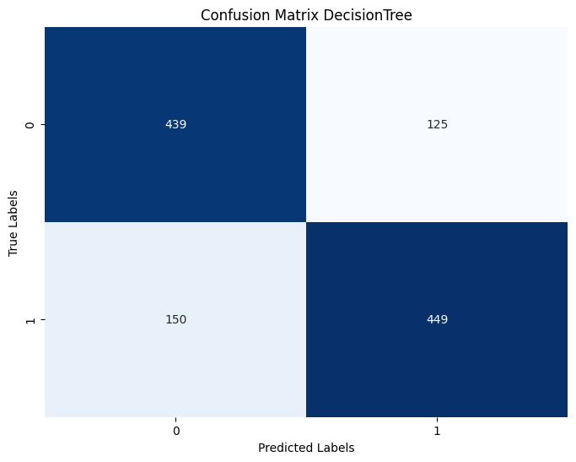
pySpark Models
Support Vector Classifier
Multi Layer Perceptron
Decision Tree
Random Forest
Gradient Boost Tree
Logistic Regression

Slide 49
pySpark Models
Support Vector Classifier
Multi Layer Perceptron
 | Precision | Recall | F1 Score | Accuracy
0 | 0.69 | 0.76 | 0.73
1 | 0.75 | 0.68 | 0.72
 |  |  |  | 0.72
Decision Tree
Random Forest
Gradient Boost Tree
Logistic Regression

Slide 50
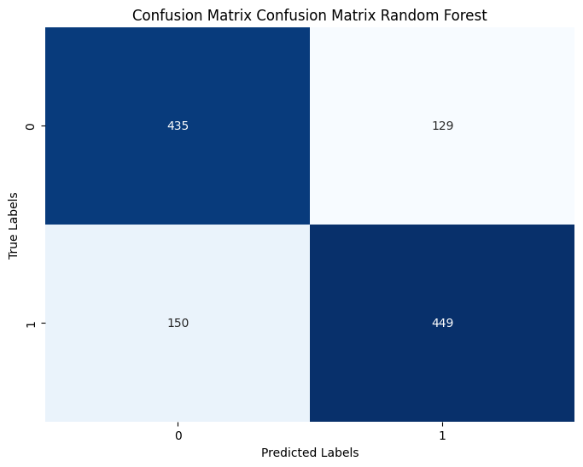
pySpark Models
Support Vector Classifier
Multi Layer Perceptron
Decision Tree
Random Forest
Gradient Boost Tree
Logistic Regression

Slide 51
pySpark Models
Support Vector Classifier
Multi Layer Perceptron
 | Precision | Recall | F1 Score | Accuracy
0 | 0.74 | 0.77 | 0.76
1 | 0.78 | 0.75 | 0.76
 |  |  |  | 0.76
Decision Tree
Random Forest
Gradient Boost Tree
Logistic Regression

Slide 52
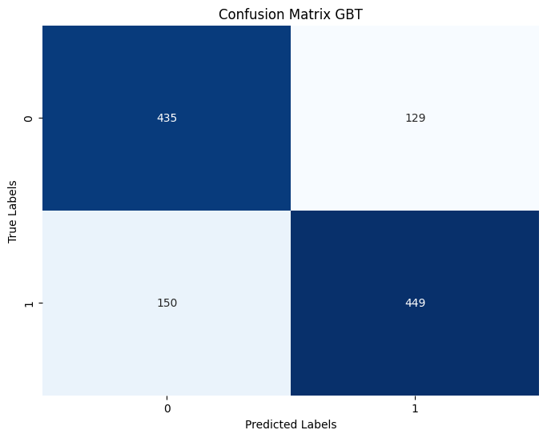
pySpark Models
Support Vector Classifier
Multi Layer Perceptron
Decision Tree
Random Forest
Gradient Boost Tree
Logistic Regression

Slide 53
pySpark Models
Support Vector Classifier
 | Precision | Recall | F1 Score | Accuracy
0 | 0.73 | 0.75 | 0.74
1 | 0.76 | 0.74 | 0.75
 |  |  |  | 0.74
Multi Layer Perceptron
Decision Tree
Random Forest
Gradient Boost Tree
Logistic Regression

Slide 54

pySpark Models
Support Vector Classifier
Multi Layer Perceptron
Decision Tree
Random Forest
Gradient Boost Tree
Logistic Regression

Slide 55
pySpark Models
Support Vector Classifier
 | Precision | Recall | F1 Score | Accuracy
0 | 0.77 | 0.79 | 0.78
1 | 0.80 | 0.77 | 0.79
 |  |  |  | 0.79
Multi Layer Perceptron
Decision Tree
Random Forest
Gradient Boost Tree
Logistic Regression

Slide 56
pySpark Models
Support Vector Classifier
Multi Layer Perceptron
Decision Tree
Random Forest
Gradient Boost Tree
Logistic Regression

Slide 57
pySpark Models
Support Vector Classifier
Multi Layer Perceptron
Decision Tree
Random Forest
Gradient Boost Tree
Logistic Regression

Slide 58
Keras LSTM

Slide 59
Keras LSTM
For the training, I’ve used the tokens that I’ve computed for the pySpark models.
Get displayed tweets
Word token from pySpark
Tokenization
Pad sequences
Prediction
Change tweet backgroud

Slide 60
Keras LSTM
For the application, I wrote the same function that I’ve used in pySpark in order to get tokens from the tweet in order to work as a standalone.
Get displayed tweets
Word token function
Tokenization
Pad sequences
Change tweet backgroud
Prediction

Slide 61
Keras LSTM
LSTM performance:
Trained in 2 epoch
Traning accuracy: 0.87
Test accuracy: 0.78
 | Precision | Recall | F1 Score | Accuracy
0 | 0.78 | 0.77 | 0.77
1 | 0.78 | 0.79 | 0.79
 |  |  |  | 0.78

Slide 62
Keras LSTM
LSTM performance:
Trained in 2 epoch
Traning accuracy: 0.87
Test accuracy: 0.78
 | Precision | Recall | F1 Score | Accuracy
0 | 0.78 | 0.77 | 0.77
1 | 0.78 | 0.79 | 0.79
 |  |  |  | 0.78
Small dataset
Small Context
Not enough samples to train a good embeddings
Why is it not performing better?

Slide 63
The Application

Slide 64
The Application
Get displayed tweets
Word token function
Tokenization
Pad sequences
Change tweet backgroud
Prediction

Slide 65
The Application
Get displayed tweets
Word token function
Tokenization
Pad sequences
Keras
Selenium
Change tweet backgroud
Prediction

Slide 66
The Application
Keras
Selenium
Machine Learning Library that offers layers and other utilities

Slide 67
The Application
Keras
Selenium
Chrome Controller that enables me to control and manipulates elements in the page

Slide 68
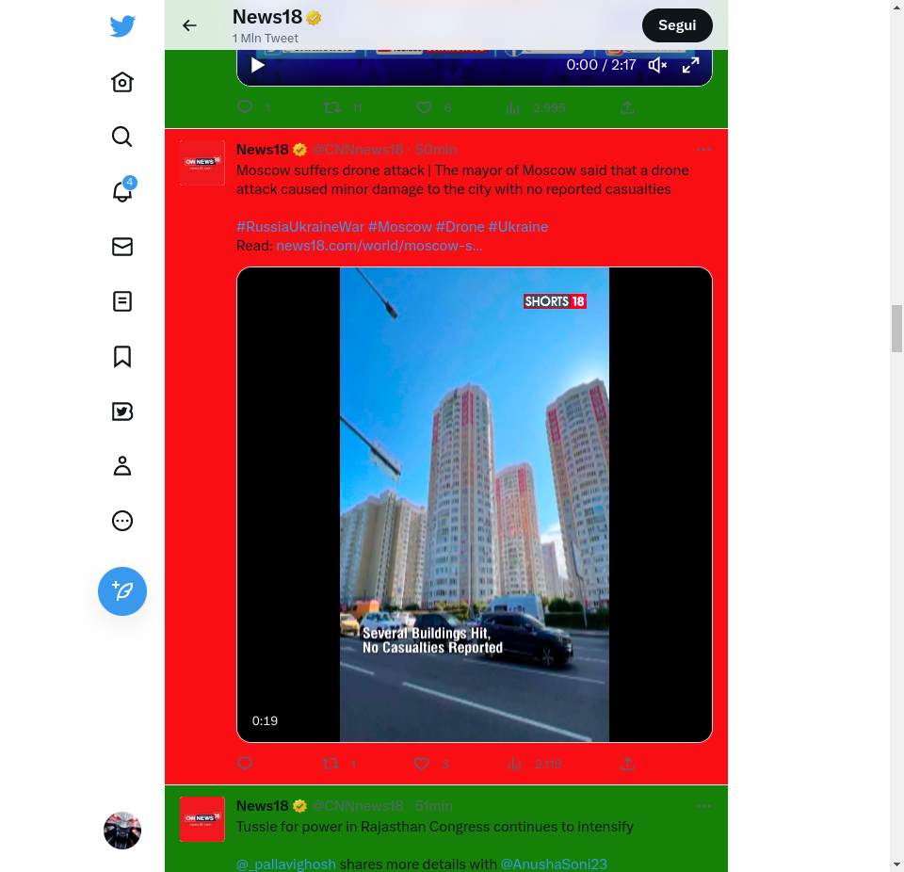
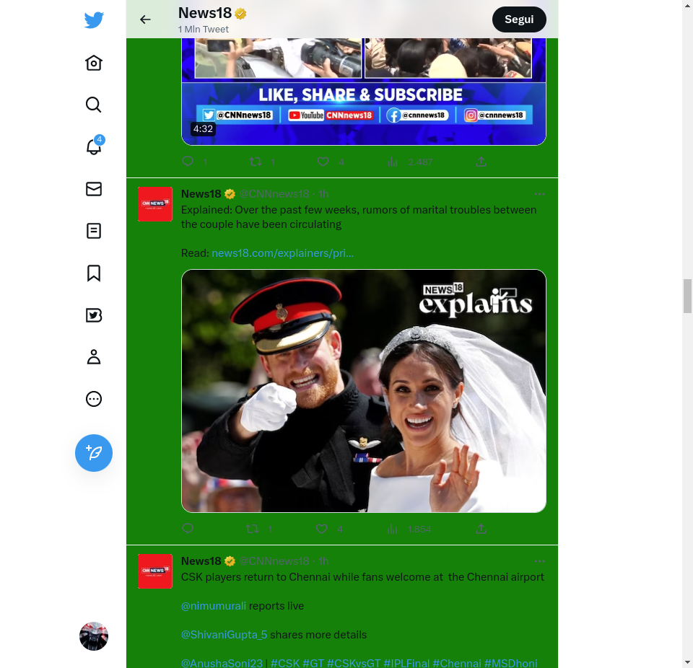
The Application
Keras
Selenium
Machine Learning Library
Chrome Controller

Slide 69
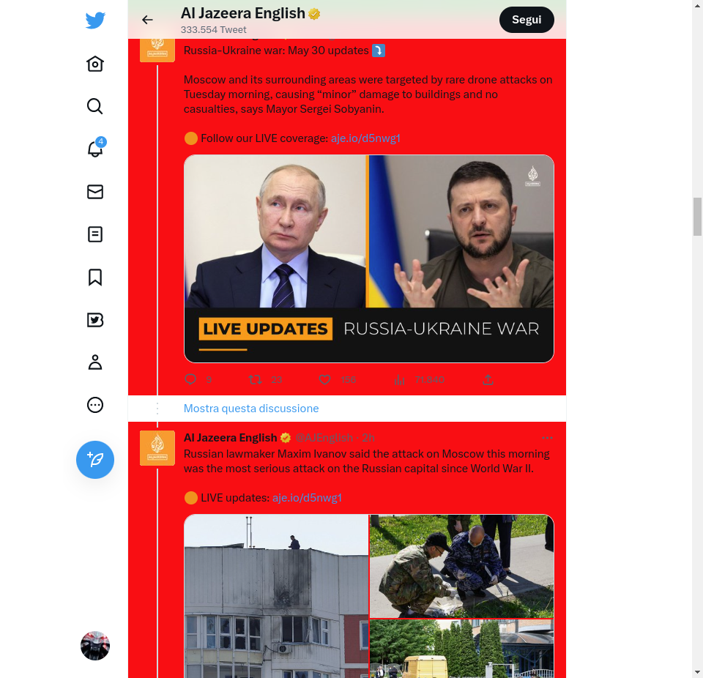
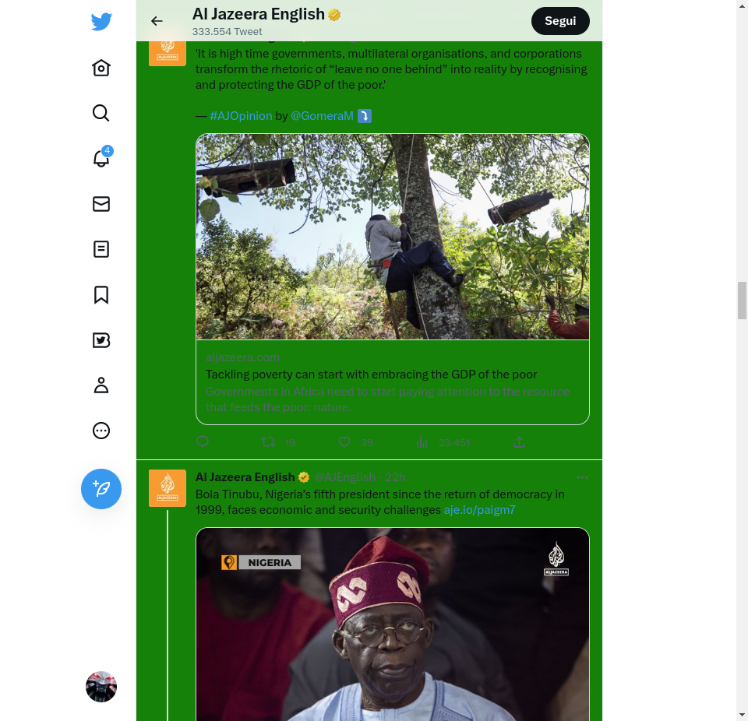
The Application
Keras
Selenium
Machine Learning Library
Chrome Controller

Slide 70
My take home message

Slide 71
My take home message
Twitter is a great source of information
500 milions tweets per day!

Slide 72
My take home message
Twitter is a great source of information
We need a way to automate the classification of tweets since they can be of help to emergency responders
500 milions tweets per day!

Slide 73
My take home message
Twitter is a great source of information
We need a way to automate the classification of tweets since they can be of help to emergency responders
Different models performed more or less the same, this is because the dataset was small
500 milions tweets per day!

Slide 74
My take home message
Twitter is a great source of information
We need a way to automate the classification of tweets since they can be of help to emergency responders
Different models performed more or less the same, this is because the dataset was small
Given a model, it can be implemented to work live using a chrome extension or to automate a browser using Selenium

Slide 75
My take home message
Twitter is a great source of information
We need a way to automate the classification of tweets since they can be of help to emergency responders
Different models performed more or less the same, this is because the dataset was small
Given a model, it can be implemented to work live using a chrome extension or to automate a browser using Selenium
Future works development for the project may be:
Creating a better training data
Use better model like Bert
Build model that supports variations of a word and typos

Slide 76
THANK YOU FOR YOUR ATTENTION

